Slide 1

Introduction
Self Balancing Tower Crane

Slide 2
Introduction
Objectives
Build a prototype of the self-balancing tower crane to validate the design concepts.
Design the mechanical structure based on the stress analysis and deflection analysis by using SOLIDWORKS.
Study the state space representation, and the dynamics of the crane.
Design a position tracking system based on pole placement or Linear Quadratic Regulator (LQR).
Test each position tracking system and study the robustness of each controller to select the most suitable one of them.
Design a full state observer to estimate the unmeasured states.

Slide 3
Introduction
Feeding the Palestinian market
No need for a driver inside the crane room
Cranes accidents

Slide 4
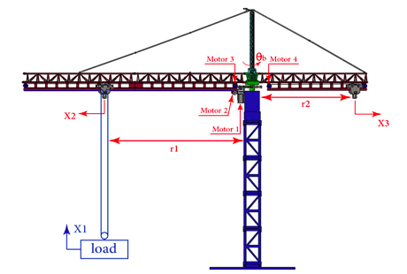
DESIGN
Tower Crane CAD Model
Design Requirements
Principle of Work

Slide 5
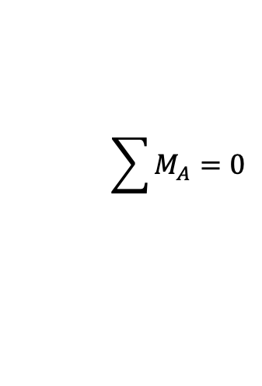
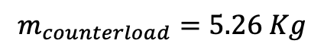
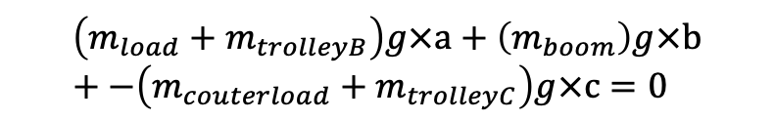
Counterweight Calculations
$$\sum{M_{A}}=0$$
$$\left(m_{load}+m_{trolleyB}\right)g×a+\left(m_{boom}\right)g×b+−\left(m_{couterload}+m_{trolleyC}\right)g×c=0$$
$$m_{counterload}=5.26 Kg$$

Slide 6
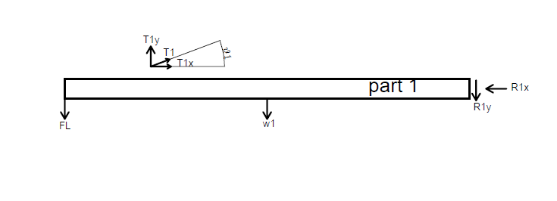
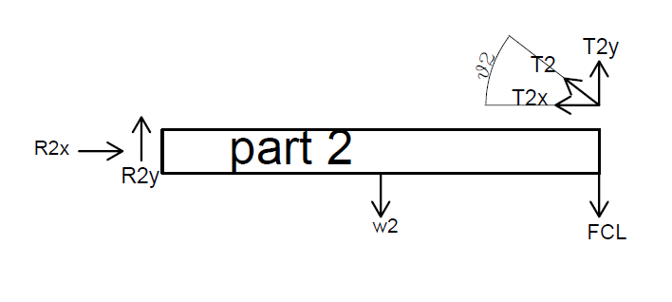
Force Analysis

Slide 7
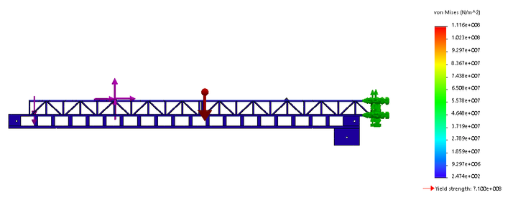
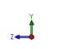
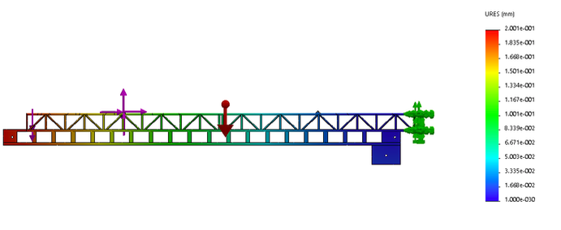
Stress and Deflection Analysis
Analysis of boom
F.O.S = 6.36
Maximum deflection = 0.2 mm

Slide 8
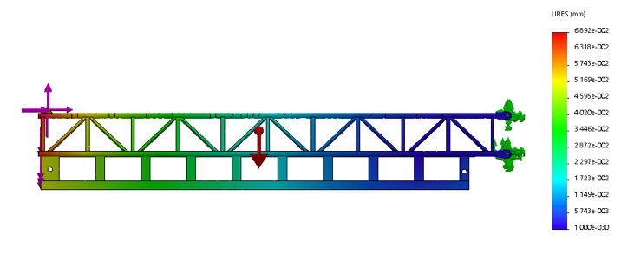
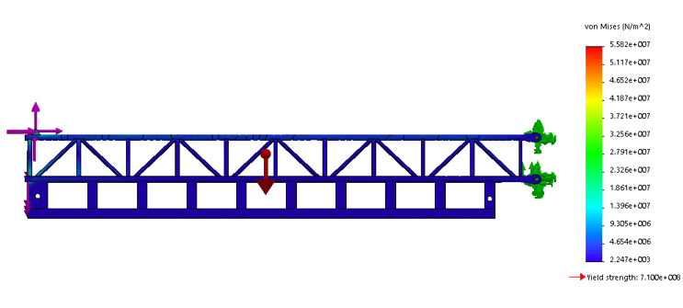
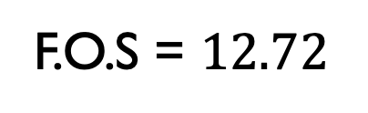
Stress and Deflection Analysis
Analysis of counter boom
F.O.S = $12.72$
Maximum deflection = 0.069 mm

Slide 9
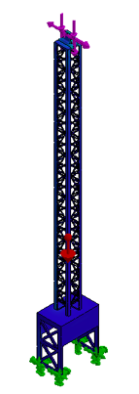
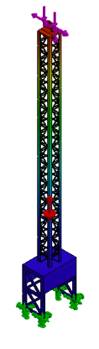
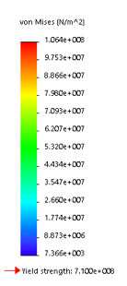
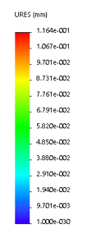
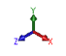
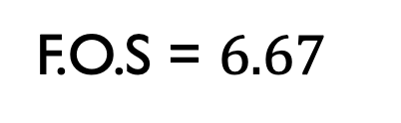
Stress and Deflection Analysis
F.O.S = $6.67$
Maximum deflection = 0.11 mm
Boom Column (Member Holder)

Slide 10
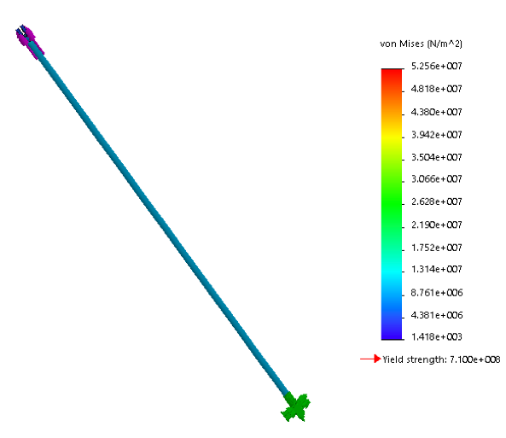
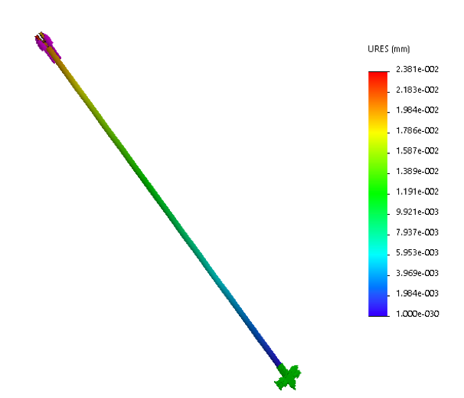
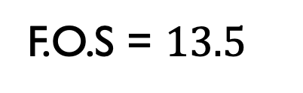
Stress and Deflection Analysis
F.O.S = $13.5$
Maximum deflection = 0.024 mm
Member1 (the load side)

Slide 11
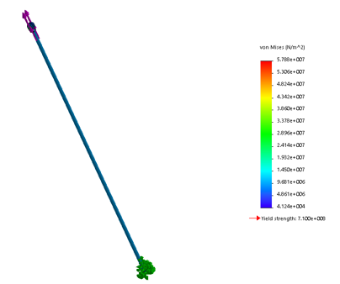
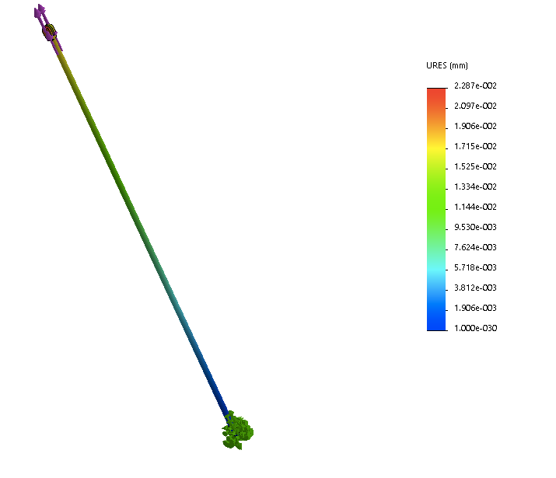
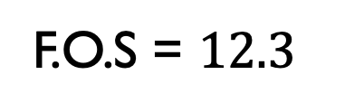
Stress and Deflection Analysis
F.O.S = $12.3$
Maximum deflection = 0.023 mm
Member 2 (the counter load side)

Slide 12
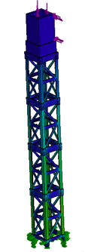
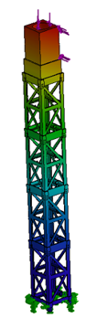
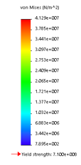
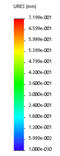
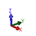
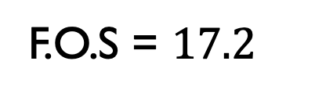
Stress and Deflection Analysis
F.O.S = $17.2$
Maximum deflection = 0.72 mm
The Mast

Slide 13
Motors selection
Motor/ Specification | Power [W] | Torque [N.m] | Speed [rpm]
Motor to Drive the Boom (M1) | 4.8 | 0.46 | 100
Motor to Lift the Load (M2) | 5 | 0.075 | 520
Motor to Drive the Load Trolley (M3) | 0.285 | 0.0142 | 100
Motor to Drive the Counter Load Trolley (M4) | 2.11 | 0.10 | 202

Slide 14
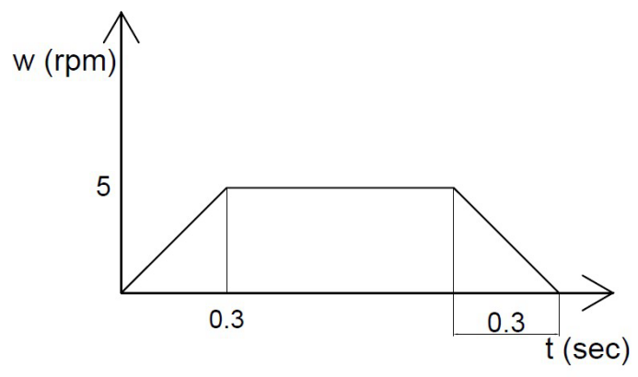
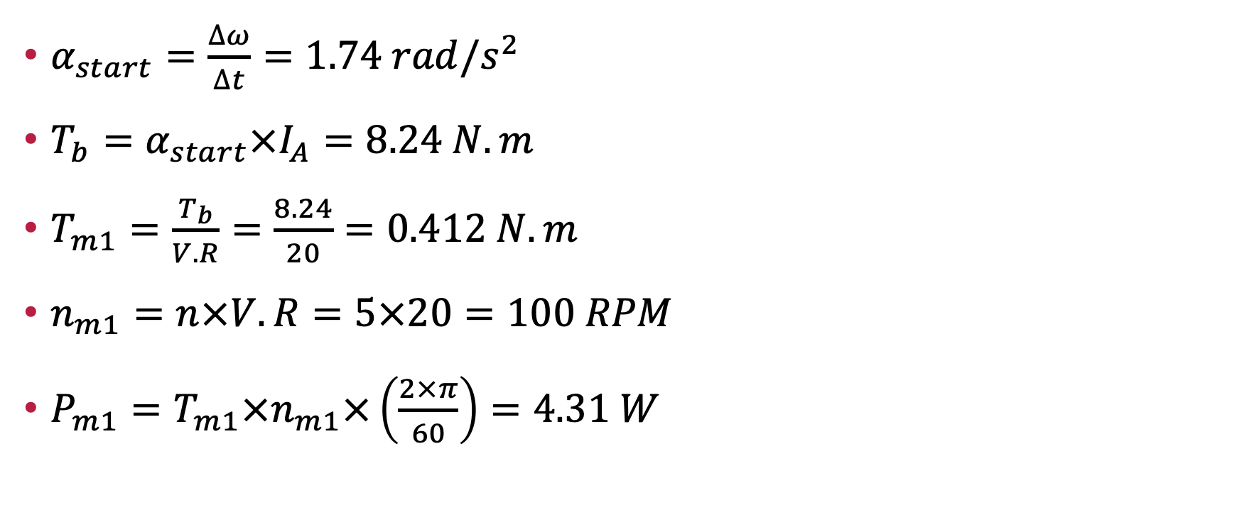
Boom Motor
$α_{start}=\frac{∆ω}{∆t}=1.74 rad/s^{2}$
$T_{b}=α_{start}×I_{A}=8.24 N.m$
$T_{m1}=\frac{T_{b}}{V.R}=\frac{8.24}{20}=0.412 N.m$
$n_{m1}=n×V.R=5×20=100 RPM$
$P_{m1}=T_{m1}×n_{m1}×\left(\frac{2×π}{60}\right)=4.31 W$

Slide 15
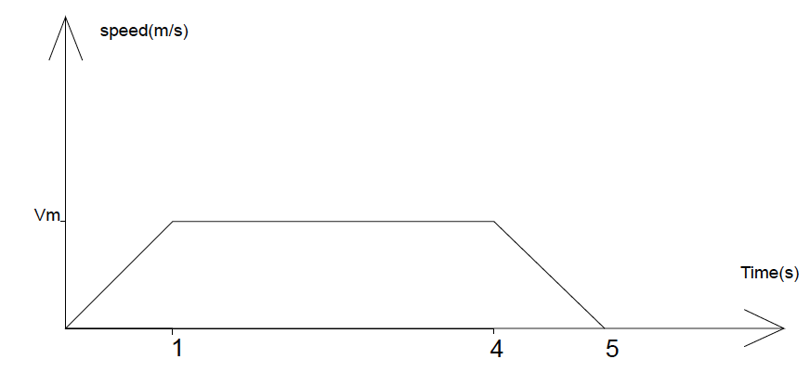
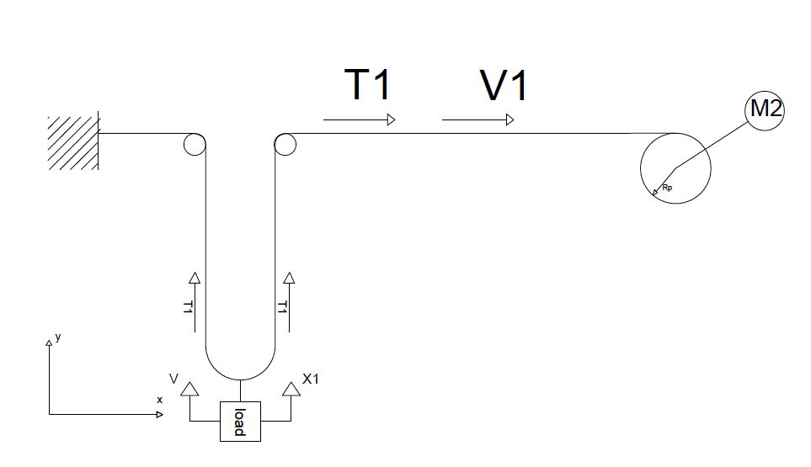
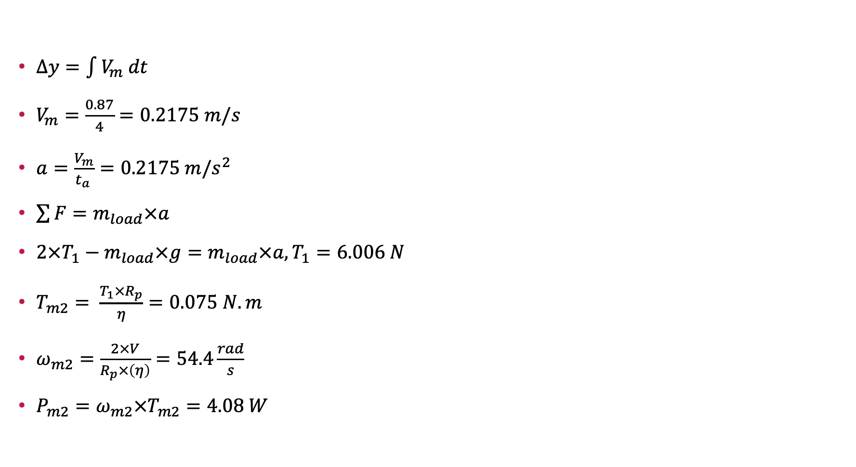
Load Motor
$∆y=\int{V_{m} dt}$
$V_{m}=\frac{0.87}{4}=0.2175 m/s$
$a=\frac{V_{m}}{t_{a }}=0.2175 m/s^{2}$
$\sum{F}=m_{load}×a$
$2×T_{1}−m_{load}×g=m_{load}×a,T_{1}=6.006 N$
$T_{m2}= \frac{T_{1}×R_{p}}{η}=0.075 N.m$
$ω_{m2}=\frac{2×V}{R_{p}×\left(η\right)}=54.4\frac{rad}{s}$
$P_{m2}=ω_{m2}×T_{m2}=4.08 W$

Slide 16
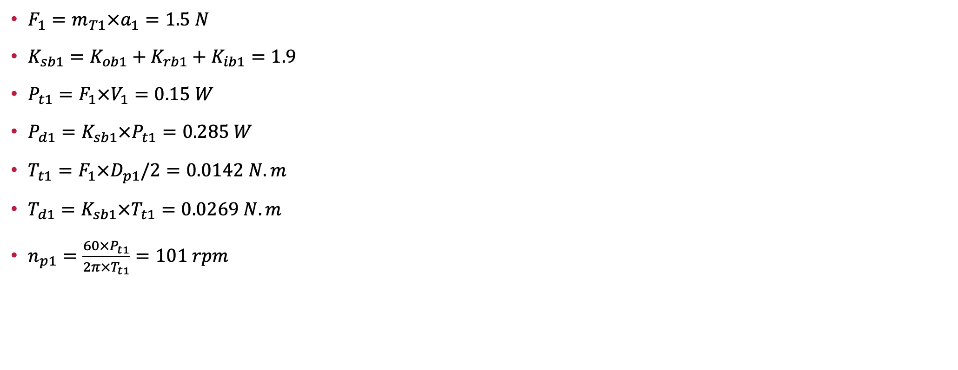
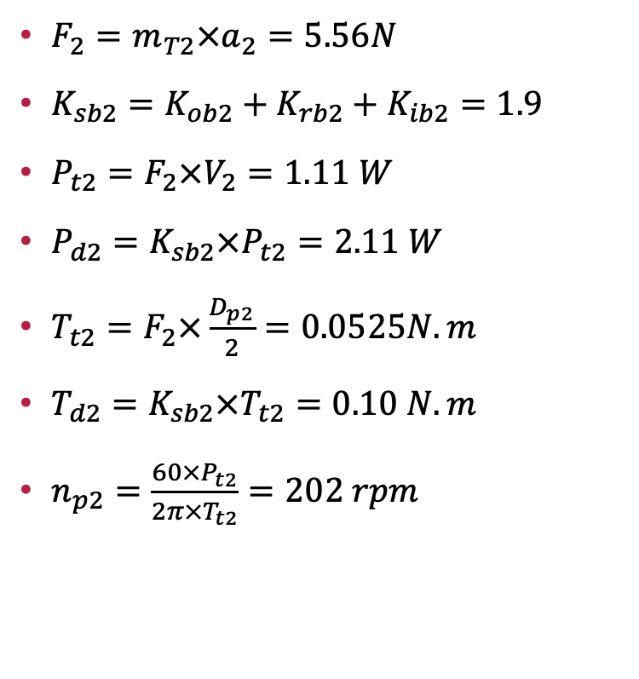
Load Trolley Motor
Counter Load Trolley Motor
$F_{1}=m_{T1}×a_{1}=1.5 N$
$K_{sb1}=K_{ob1}+K_{rb1}+K_{ib1}=1.9$
$P_{t1}=F_{1}×V_{1}=0.15 W$
$P_{d1}=K_{sb1}×P_{t1}=0.285 W$
$T_{t1}=F_{1}×D_{p1}/2=0.0142 N.m$
$T_{d1}=K_{sb1}×T_{t1}=0.0269 N.m$
$n_{p1}=\frac{60×P_{t1}}{2π×T_{t1}}=101 rpm$
$F_{2}=m_{T2}×a_{2}=5.56N$
$K_{sb2}=K_{ob2}+K_{rb2}+K_{ib2}=1.9$
$P_{t2}=F_{2}×V_{2}=1.11 W$
$P_{d2}=K_{sb2}×P_{t2}=2.11 W$
$T_{t2}=F_{2}×\frac{D_{p2}}{2}=0.0525N.m$
$T_{d2}=K_{sb2}×T_{t2}=0.10 N.m$
$n_{p2}=\frac{60×P_{t2}}{2π×T_{t2}}=202 rpm$

Slide 17
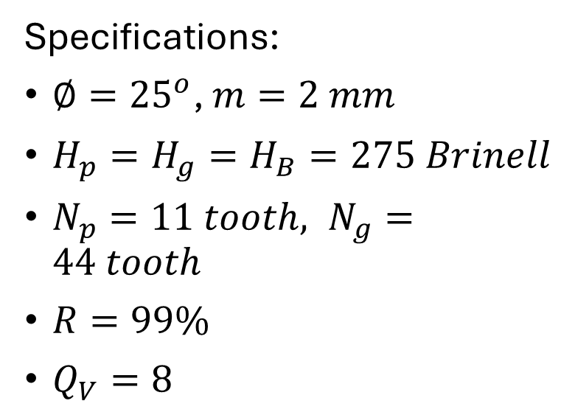
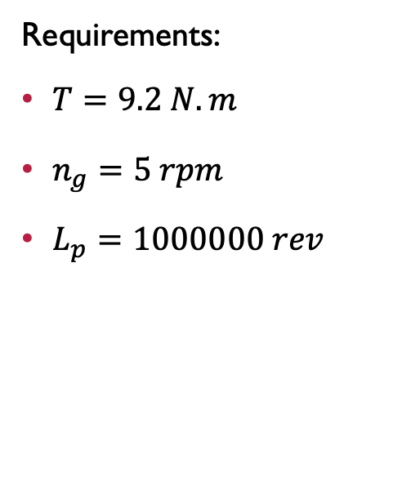
Gear Design
Specifications:
$∅={25}^{o}$, $m=2 mm$
$H_{p}=H_{g}=H_{B}=275 Brinell$
$N_{p}=11 tooth, N_{g}=44 tooth$
$R=99\%$
$Q_{V}=8$
Requirements:
$T=9.2 N.m$
$n_{g}=5 rpm$
$L_{p}=1000000 rev$

Slide 18
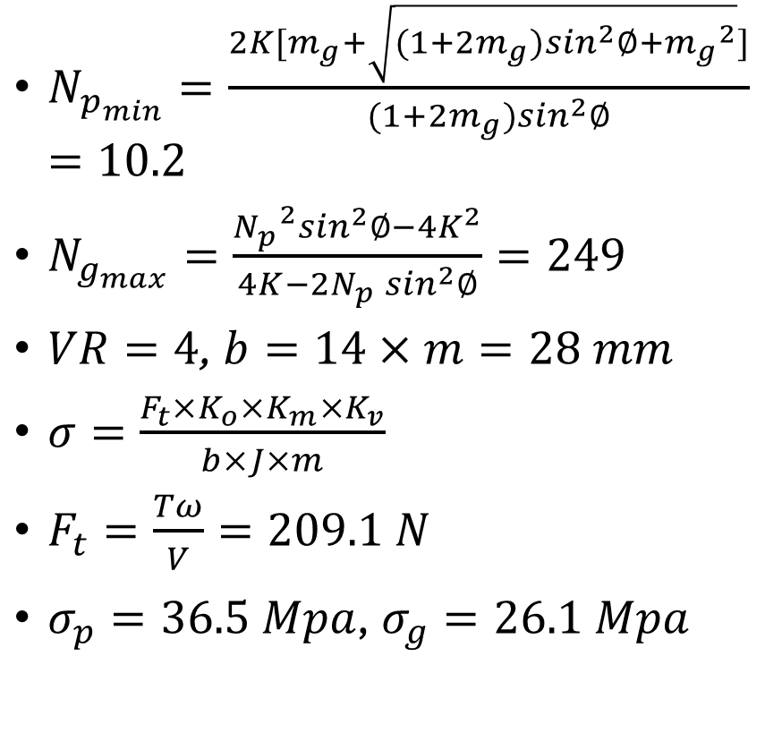
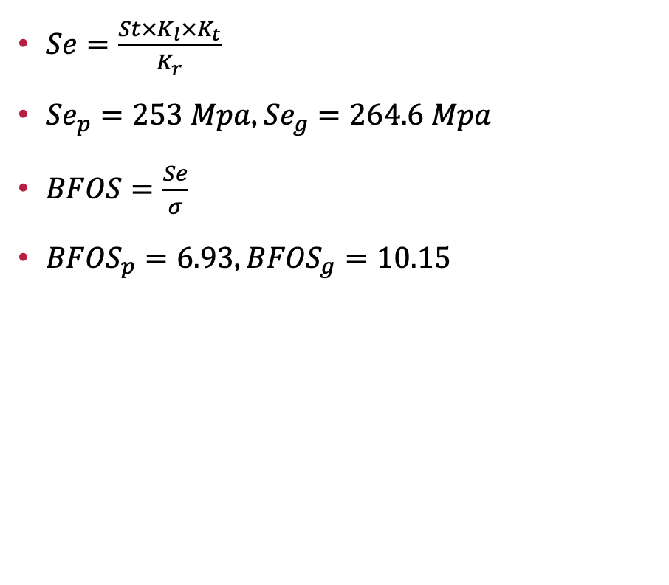
Gear Design
$N_{p_{min}}=\frac{2K[m_{g}+\sqrt{(1+2m_{g})\sin^{2}∅+{m_{g}}^{2}}]}{(1+2m_{g})\sin^{2}∅}=10.2$
$N_{g_{max}}=\frac{{N_{p}}^{2}\sin^{2}∅−4K^{2}}{4K−2N_{p}\sin^{2}∅}=249$
$VR=4$, $b=14×m=28 mm$
$σ=\frac{F_{t}×K_{o}×K_{m}×K_{v}}{b×J×m}$
$F_{t}=\frac{Tω}{V}=209.1 N$
$σ_{p}=36.5 Mpa\text{,} { σ}_{g}=26.1 Mpa$
$Se=\frac{St×K_{l}×K_{t}}{K_{r}}$
${Se}_{p}=253 Mpa$, ${Se}_{g}=264.6 Mpa$
$BFOS=\frac{Se}{σ}$
${BFOS}_{p}=6.93$, ${BFOS}_{g}=10.15$

Slide 19
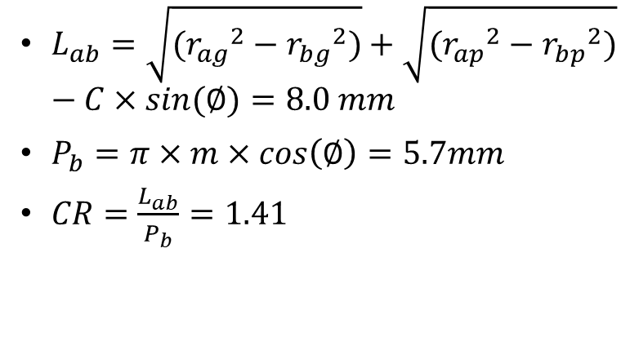
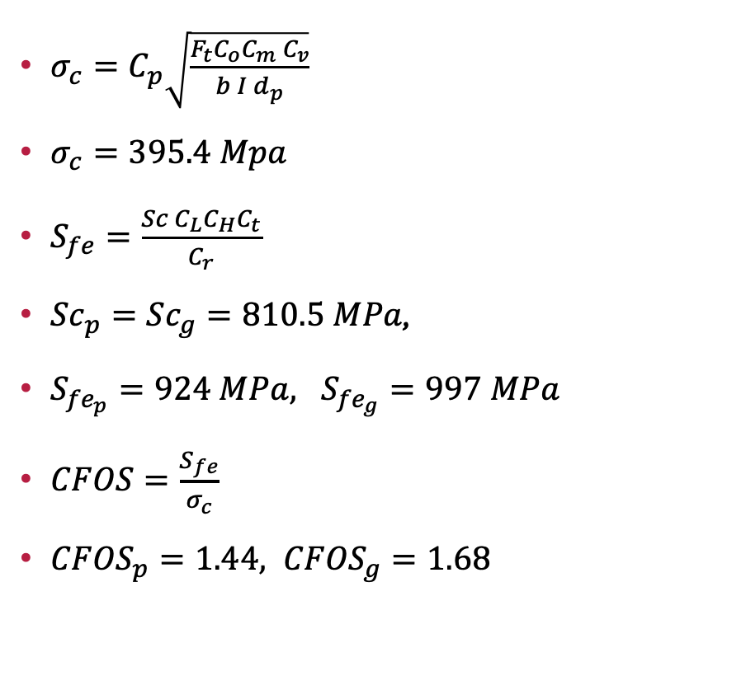
Gear Design
$σ_{c}=C_{p}\sqrt{\frac{F_{t}C_{o}C_{m}{ C}_{v}}{b I d_{p}}}$
$σ_{c}=395.4 Mpa$
$S_{fe}=\frac{Sc C_{L}C_{H}C_{t}}{C_{r}}$
${Sc}_{p}={Sc}_{g}=810.5 MPa$,
$S_{{fe}_{p}}=924 MPa, S_{{fe}_{g}}=997 MPa$
$CFOS=\frac{S_{fe}}{σ_{c}}$
${CFOS}_{p}=1.44, {CFOS}_{g}=1.68$
$L_{ab}=\sqrt{({r_{ag}}^{2}−{r_{bg}}^{2})}+\sqrt{({r_{ap}}^{2}−{r_{bp}}^{2})}−C×sin(∅)=8.0 mm$
$P_{b}=π×m×cos\left(∅\right)=5.7mm$
$CR=\frac{L_{ab}}{P_{b}}=1.41$

Slide 20
Bearing Selection

Slide 21
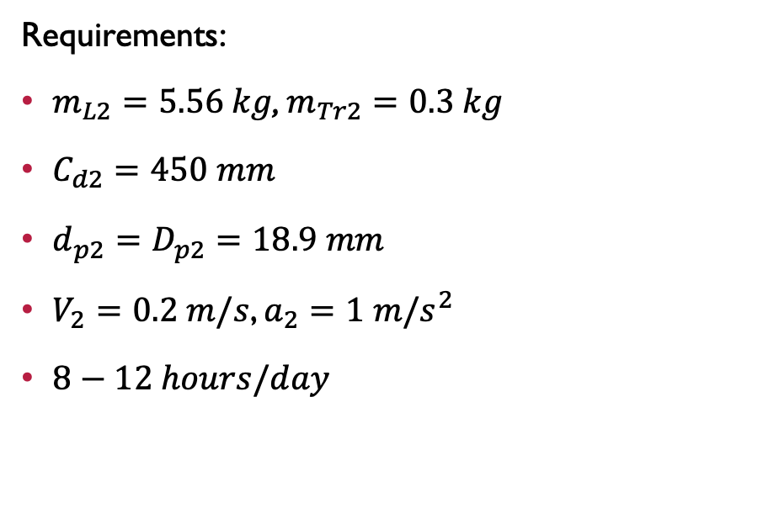
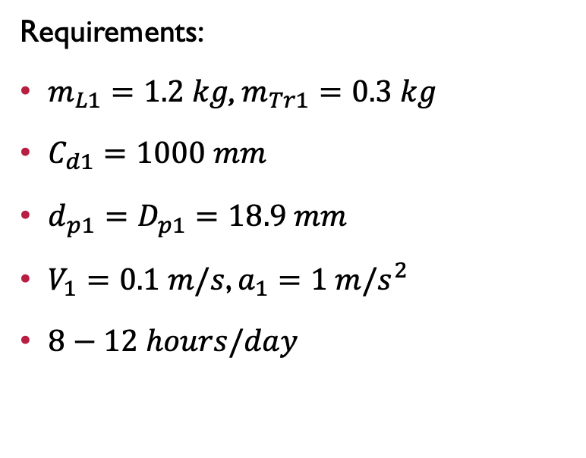
Timing Belt
Requirements:
$m_{L1}=1.2 kg$, $m_{Tr1}=0.3 kg$
$C_{d1}=1000 mm$
$d_{p1}=D_{p1}=18.9 mm$
$V_{1}=0.1 m/s$, $a_{1}=1 m/s^{2}$
$8−12 hours/day$
Requirements:
$m_{L2}=5.56 kg$, $m_{Tr2}=0.3 kg$
$C_{d2}=450 mm$
$d_{p2}=D_{p2}=18.9 mm$
$V_{2}=0.2 m/s$, $a_{2}=1 m/s^{2}$
$8−12 hours/day$

Slide 22
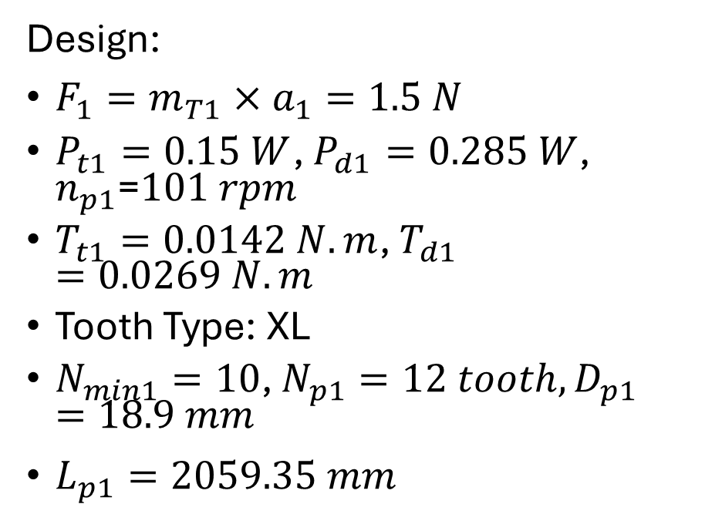
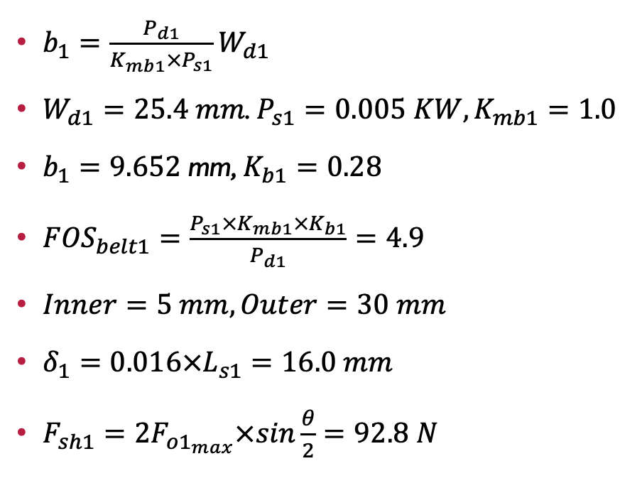
Timing Belt
Design:
$F_{1}=m_{T1}×a_{1}=1.5 N$
$P_{t1}=0.15 W$, $P_{d1}=0.285 W$, $n_{p1}$=$101 rpm$
$T_{t1}=0.0142 N.m$, $T_{d1}=0.0269 N.m$
Tooth Type: XL
$N_{min1}=10$, $N_{p1}=12 tooth, D_{p1}=18.9 mm$
$L_{p1}=2059.35 mm$
$b_{1}=\frac{P_{d1}}{K_{mb1}×P_{s1}}W_{d1}$
$W_{d1}=25.4 mm$. $P_{s1}=0.005 KW, K_{mb1}=1.0$
$b_{1}=9.652$mm, $K_{b1}=0.28$
${FOS}_{belt1}=\frac{P_{s1}×K_{mb1}×K_{b1}}{P_{d1}}=4.9$
$Inner=5 mm, Outer=30 mm$
$δ_{1}=0.016×L_{s1}=16.0 mm$
$F_{sh1}=2F_{{o1}_{max}}×sin\frac{θ}{2}=92.8 N$

Slide 23
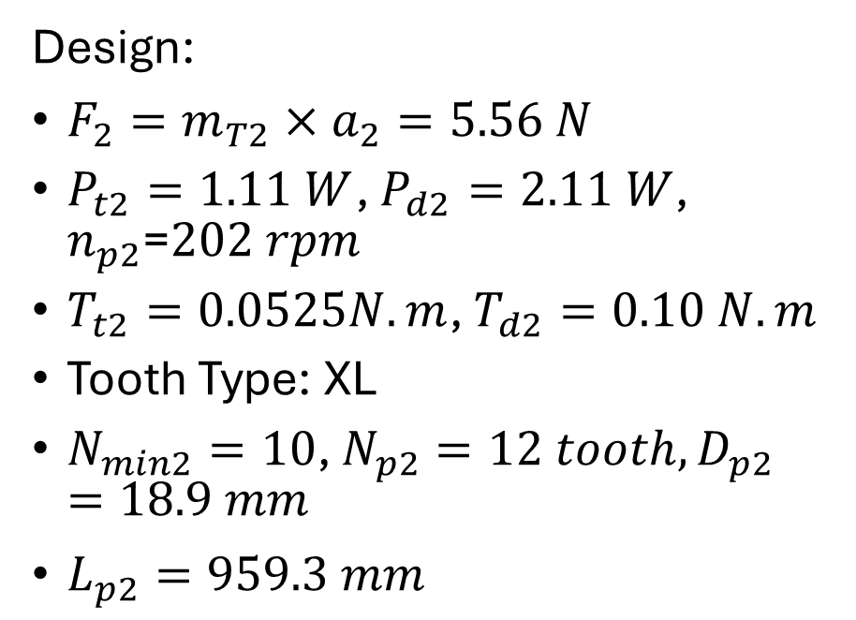

Timing Belt
Design:
$F_{2}=m_{T2}×a_{2}=5.56 N$
$P_{t2}=1.11 W$, $P_{d2}=2.11 W$, $n_{p2}$=$202 rpm$
$T_{t2}=0.0525N.m$, $T_{d2}=0.10 N.m$
Tooth Type: XL
$N_{min2}=10$, $N_{p2}=12 tooth, D_{p2}=18.9 mm$
$L_{p2}=959.3 mm$
$b_{2}=\frac{P_{d2}}{K_{mb2}×P_{s2}}W_{d2}$
$W_{d2}=25.4 mm$. $P_{s2}=0.010 KW, K_{mb2}=1.0$
$b_{2}=9.652$mm, $K_{b2}=0.28$
${FOS}_{belt2}=\frac{P_{s2}×K_{mb2}×K_{b2}}{P_{d2}}=1.33$
$Inner=5 mm, Outer=15 mm$
$δ_{2}=0.016×L_{s1}=7. mm$
$F_{sh2}=2F_{{o2}_{max}}×sin\frac{θ}{2}=92.8 N$

Slide 24
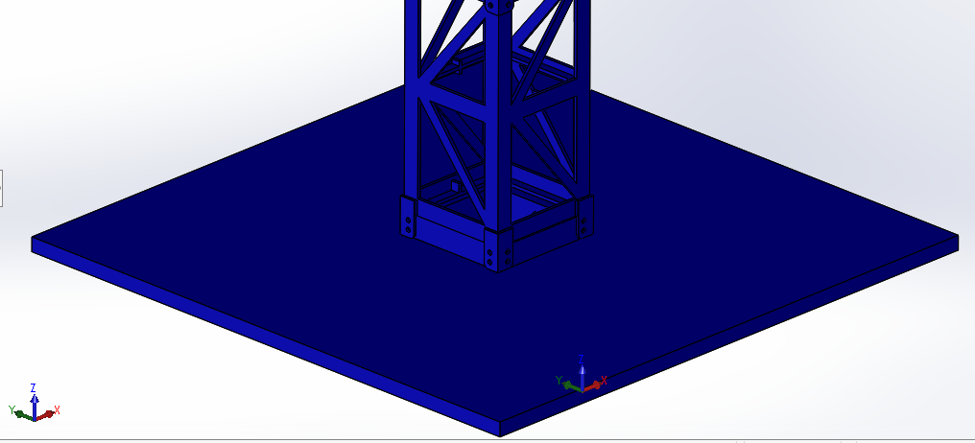
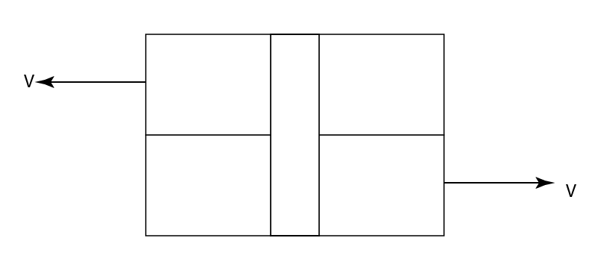

Pins Design
Pins at the mast holder
$w_{above}=154.0 N$
$d_{pi}=0.00343 m$
$A_{pi}=9.24×{10}^{−6}m^{2}$
$V=\frac{w_{above}}{16}=9.6 N$
$σ_{pi}=\frac{V}{A_{pi}}=1.04 Mpa$
$Str = 758 MPa$
${F.O.S}_{pi}=\frac{Str}{σ_{p}}=727$

Slide 25



Pins Design
Pins at the ropes
$T_{2}=127.5 N$
$d_{pi}=0.002 m$
$A_{pi}=3.14×{10}^{−6}m^{2}$
$σ_{pi}=\frac{T_{2}}{2A_{pi}}=20.3 Mpa$
$Str = 758 MPa$
${F.O.S}_{pi}=\frac{Str}{σ_{p}}=37$

Slide 26


Pins Design
Pins at the boom
$R=\sqrt{{R_{x}}^{2}+{R_{y}}^{2}}=113.6 N$
$d_{pi}=0.0035 m$
$A_{pi}=9.62×{10}^{−6}m^{2}$
$R_{pi}=\frac{R}{3}=37.9 N$
$σ_{pi}=\frac{R_{pi}}{2A_{pi}}=1.97 Mpa$
$Str = 758 MPa$
${F.O.S}_{pi}=\frac{Str}{σ_{p}}=385$

Slide 27



Pins Design
Pins at the rope holder
$\sum{F_{x}}=0$, $R_{x}=3.4 N$
$\sum{F_{y}}=0$, $R_{y}=108.8 N$
$\sum{M_{o}}=0$, $M=0.9384 N.m$
$F=0.9384/0.0025=37.54 N$
$R_{pi}=\sqrt{{(F/2+R_{y}/4)}^{2}+{(R_{x}/4)}^{2}}=45.98 N$
$A_{pi}=3.14×{10}^{−6}m^{2}$
$σ_{pi}=\frac{R_{pi}}{2A_{pi}}=7.32Mpa$
$Str = 758 MPa$
${F.O.S}_{pi}=\frac{Str}{σ_{p}}=103.6$

Slide 28
Dynamic Analysis, and control
Mathematical Model of the Tower Crane
State-Space Representation of the Tower Crane
CONTROL SYSTEM DESIGN

Slide 29









Mathematical Model of the Tower Crane
The Angular Position of the Boom ($θ_{B}$)
Height of Load
$$J_{(B+L)}$$
$$J_{eq}=J_{B}+\left(m_{lt}×r_{1}^{2}\right)+(m_{clt}×r_{2}^{2})+J_{G}+J_{P}×{\left(m_{g}\right)}^{2}$$
$$\sum{F}= m_{l} × {\ddot{x}}_{1}$$
$$\sum{T}= J_{eq} × {\ddot{θ}}_{B}$$
$${\ddot{x}}_{1}= \frac{2}{R_{pR}{×m}_{l}}×T_{m2}−g$$
$${\ddot{θ}}_{B}= \frac{T_{m1} × \left(VR\right)− D_{eq} ×{\dot{θ}}_{B}}{J_{eq}}$$

Slide 30



Mathematical Model of the Tower Crane
Position of Trolley B
$$\sum{F}= m_{tl} × {\ddot{x}}_{2}$$
$${\ddot{x}}_{2}= \frac{1}{R_{p}×m_{tl}} × T_{m3}− \frac{D_{3}}{m_{tl}} ×{\dot{x}}_{2}$$

Slide 31









State-Space Representation of the Tower Crane
$${\ddot{θ}}_{B}=\frac{V.R}{J_{eq}} × T_{m1}− \frac{D_{eq}}{J_{eq}} × {\dot{θ}}_{B}$$
$$\dot{x}=Ax+Bu$$
$$y=Cx+Du$$
$${\ddot{x}}_{1}= \frac{2}{R_{pR}{×m}_{l}}×T_{m2}−g$$
[A B C D]
$$y=\left[\begin{matrix}θ_{B} \\ X_{1} \\ \begin{matrix}X_{2} \\ X_{3}\end{matrix}\end{matrix}\right]$$
$$x= \left[\begin{matrix}θ_{B} \\ x_{1} \\ \begin{matrix}x_{2} \\ x_{3} \\ \begin{matrix}{\dot{θ}}_{B} \\ {\dot{x}}_{1} \\ \begin{matrix}{\dot{x}}_{2} \\ {\dot{x}}_{3}\end{matrix}\end{matrix}\end{matrix}\end{matrix}\right]$$
$${\ddot{x}}_{2}= \frac{1}{R_{p}×m_{tl}} × T_{m3}− \frac{D_{2}}{m_{tl}} ×{\dot{ x}}_{2}$$
$$u=\left[\begin{matrix}T_{m1} \\ T_{m2} \\ \begin{matrix}T_{m3} \\ T_{m4} \\ 1\end{matrix}\end{matrix}\right]$$
$${\ddot{x}}_{3}= \frac{1}{R_{p}×m_{Tcl}} × T_{m4}− \frac{D_{3}}{m_{Tcl}} ×{\dot{x}}_{3}$$

Slide 32




State-Space Representation of the Tower Crane
$$B=\left[\begin{matrix}0 & 0 & 0 & 0 & 0 \\ 0 & 0 & 0 & 0 & 0 \\ 0 & 0 & 0 & 0 & 0 \\ 0 & 0 & 0 & 0 & 0 \\ \frac{V.R}{J_{eq}} & 0 & 0 & 0 & 0 \\ 0 & \frac{2}{R_{pR}{×m}_{l}} & 0 & 0 & −g \\ 0 & 0 & \frac{1}{R_{p}×m_{tl}} & 0 & 0 \\ 0 & 0 & 0 & \frac{1}{R_{p}×m_{Tcl}} & 0\end{matrix}\right]$$
$$A=\left[\begin{matrix}0 & 0 & 0 & 0 & 1 & 0 & 0 & 0 \\ 0 & 0 & 0 & 0 & 0 & 1 & 0 & 0 \\ 0 & 0 & 0 & 0 & 0 & 0 & 1 & 0 \\ 0 & 0 & 0 & 0 & 0 & 0 & 0 & 1 \\ 0 & 0 & 0 & 0 & − \frac{D_{eq}}{J_{eq}} & 0 & 0 & 0 \\ 0 & 0 & 0 & 0 & 0 & 0 & 0 & 0 \\ 0 & 0 & 0 & 0 & 0 & 0 & − \frac{D_{2}}{m_{tl}} & 0 \\ 0 & 0 & 0 & 0 & 0 & 0 & 0 & − \frac{D_{3}}{m_{Tcl}}\end{matrix}\right]$$
$$C=\left[\begin{aligned}&\begin{matrix}1 & 0 & \begin{matrix}0 & 0 & \begin{matrix}0 & 0 & \begin{matrix}0 & 0\end{matrix}\end{matrix}\end{matrix}\end{matrix} \\ &\begin{matrix}0 & 1 & \begin{matrix}0 & 0 & \begin{matrix}0 & 0 & \begin{matrix}0 & 0\end{matrix}\end{matrix}\end{matrix}\end{matrix} \\ &\begin{matrix}0 & 0 & \begin{matrix}1 & 0 & \begin{matrix}0 & 0 & \begin{matrix}0 & 0\end{matrix}\end{matrix}\end{matrix}\end{matrix} \\ &\begin{matrix}0 & 0 & \begin{matrix}0 & 1 & \begin{matrix}0 & 0 & \begin{matrix}0 & 0\end{matrix}\end{matrix}\end{matrix}\end{matrix}\end{aligned}\right]$$
$$D=\left[\begin{matrix}0 & 0 & 0 & 0 & 0 \\ 0 & 0 & 0 & 0 & 0 \\ 0 & 0 & 0 & 0 & 0 \\ 0 & 0 & 0 & 0 & 0\end{matrix}\right]$$

Slide 33
CONTROL SYSTEM DESIGN
Controllability and Observability of the System
Control Design
Observer Design
Real Time Simulink

Slide 34




$$\text{Controllability} \text{and} \text{Obsevability}$$
$$\overline{B}=\left[\begin{matrix}7.6923×{10}^{3} & 0 & 0 & 0 & 0 \\ 0 & 2.079×{10}^{293} & 0 & 0 & −1.2237×{10}^{293} \\ 0 & 0 & 37.913 & 0 & 0 \\ 0 & 0 & 0 & 16.829 & 0 \\ 7.6923×{10}^{3} & 0 & 0 & 0 & 0 \\ 0 & 2.079×{10}^{293} & 0 & 0 & −1.2237×{10}^{293} \\ 0 & 0 & 163.20 & 0 & 0 \\ 0 & 0 & 0 & 25.38 & 0\end{matrix}\right]$$
$\overline{A}=Q^{−1}AQ$
$\overline{B}=Q^{−1}B$
$\overline{C}=CQ$
$$\overline{A}=\left[\begin{matrix}0 & 0 & 0 & 0 & 0 & 0 & 0 & 0 \\ 0 & 0 & 0 & 0 & 0 & 0 & 0 & 0 \\ 0 & 0 & 0 & 0 & 0 & 0 & 0 & 0 \\ 0 & 0 & 0 & 0 & 0 & 0 & 0 & 0 \\ 0 & 0 & 0 & 0 & −5.9682×{10}^{−4} & 0 & 0 & 0 \\ 0 & 0 & 0 & 0 & 0 & 0 & 0 & 0 \\ 0 & 0 & 0 & 0 & 0 & 0 & −4.1867 & 0 \\ 0 & 0 & 0 & 0 & 0 & 0 & 0 & −1.1289 \end{matrix}\right]$$
$$\overline{C}=\left[\begin{matrix}1 & 0 & 0 & 0 & −1 & 0 & 0 & 0 \\ 0 & 1 & 0 & 0 & 0 & −1 & 0 & 0 \\ 0 & 0 & 1 & 0 & 0 & 0 & −0.232 & 0 \\ 0 & 0 & 0 & 1 & 0 & 0 & 0 & −0.663\end{matrix}\right]$$

Slide 35


Control Design
Simulink description
Feedback gains
Inputs and outputs
$x_{3}=\frac{\left(m_{load}+m_{trolleyB}\right)×x_{2}+\left(m_{boom}\right)×d_{b}}{\left(m_{couterload}+m_{trolleyC}\right)}$

Slide 36



Pole Placement controller
What is the concept of pole placement ?
K= place (A, B, P)
K is a ($5×8$) matrix

Slide 37



LQR controller
What is the concept of LQR?
$J=\int_{0}^{∞}{(x^{T}Qx+u^{T}Ru)dt}$
K= lqr (A, B, Q, R)

Slide 38

Observer Design
Observer

Slide 39

Observer Design
Observer: Pole Placement

Slide 40

CONTROL SYSTEM DESIGN
Observer: LQR
Q_obs = eye(8);
R_obs = eye(4)*0.01
K_obs =

Slide 41

Real Time Simulink
DAC NI 6229 M series is used to connect the motors
the card NI PCI-6601 is used to connect the encoders
What the gains task ?

Slide 42
COST ESTIMATION
Part name | Quantity | Price per unit | Total price
AC servo motor model ATO40ST-M00130220 | 3 | 305$ | 915$
AC servo motor (60DNAMA1-0D40DKAK) | 1 | 350$ | 350$
Spur gear | One pair | 100$ | 100$
Tapered bearings | 2 | 20$ | 40$
Gearbox 1:5 | 1 | 52$ | 52$
Trolley | 2 | 85$ | 170$
Belt | 2 | 5$ | 10$
Data acquisition card (NI 6221 M series ) | 1 | 369$ | 369$
Data acquisition card (NI 6601 M series ) | 1 | 39$ | 39$
Total price | - | - | 2045$

